Slide 1
FAMILY &FRIENDS 1
National Edition

Slide 2
UNIT 5 : THIS IS MY NOSE!
LESSON 4 : NUMBERS

Slide 4
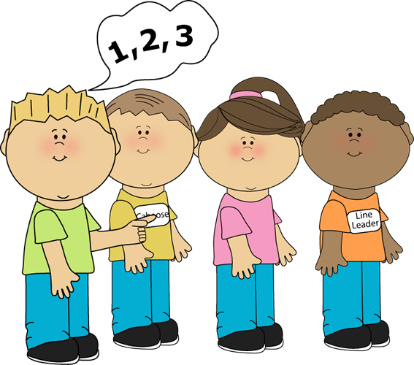
RE-ORDER
GAME
Notes:
- Ask five students to come to the front and stand in a line.
- They each call out the numbers 1 to 5 in order.
- The rest of the class points to each student and gives them a different number (from 1 to 5).
- The five students put themselves into order and they call out their new number. Repeat with other students

Slide 6
Notes:
Listen, point, and repeat. Write. Track 68
- Play the track and point to the pictures.
- Play the track again and point to the words.
- Encourage the students to copy you.
- Play the track several times for the students to practice repeating the numbers.
- Finally, model the writing activity.

Slide 7
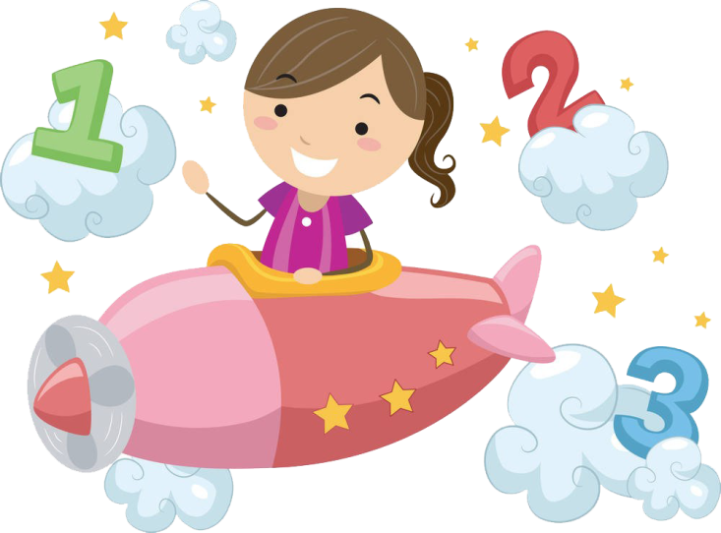
Match and say
Notes:
Match and say.
- Point to the number words and ask students to follow them while you read each one.
- Repeat and ask students to say the words with you.
- Point to the number 1 above, and say One. Say: Let’s match!
Match it with the word one.
- Repeat with the other numbers and words. Students match and say the numbers.
Below level:
- Support the students by pointing to the initial letter of each word to help them match.
- Write four and five on the board and sound out the words.
At level: Complete Exercise 2 as described above.
Above level:
- Copy the exercise on the board.
- Ask individuals to come to the board to draw matching lines between the numbers and the words.
- Rub out the initial letters of each word and ask individuals to complete the words.

Slide 8
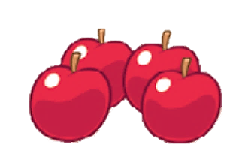
Count and say
Let’s count
the apples !
Notes:
Count and say.
- Point to the word apples and say How many apples? Point to each apple one at a time and count.
- Encourage the students to count with you. Say four apples.
- Repeat with the two other images.
- Students work in pairs asking and answering

Slide 9
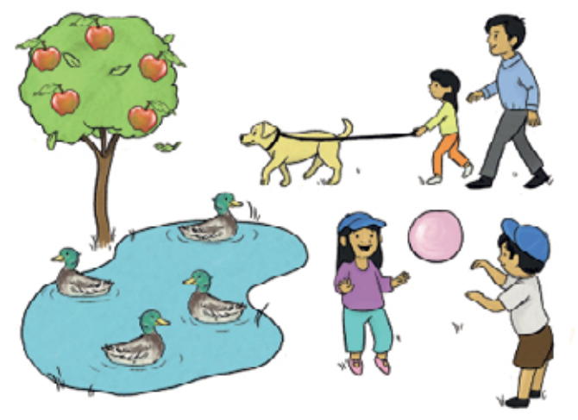
Count, circle, and say.
Notes:
Count, circle, and say.
- Point to the smaller pictures, eliciting the words from the class.
- Point to the bigger picture and say Let’s count the apples!
- Point, count, and circle the apples in the bigger picture, encouraging the students to join in with you. Then get the students to repeat the answer Five apples!
- Repeat with the other three items in the image
- Pair work: point and say

Slide 10
Goodbye !

